Slide 1

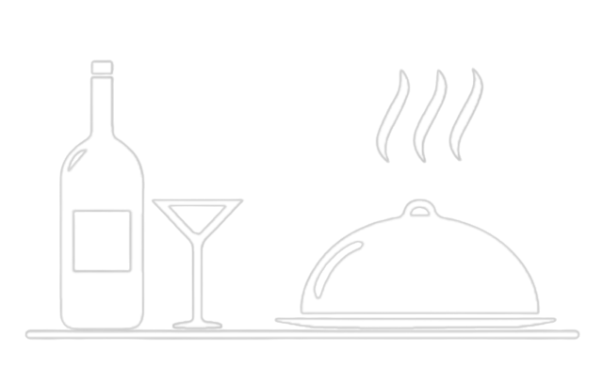
Project Challenge
Domain:
Food and Beverage
Industry
Created by:
Sai Subham Jena

Slide 2
Table of Content
01
Introduction
02
Domain Knowledge
03
Key Metrics
04
Primary Insights
05
Forecasting
06
Secondary Insights
07
Conclusion

Slide 3
Table of Content
01
Introduction
02
Domain Knowledge
03
Key Metrics
04
Primary Insights
05
Forecasting
06
Secondary Insights
07
Conclusion

Slide 4
Table of Content
01
Introduction
02
Domain Knowledge
03
Key Metrics
04
Primary Insights
05
Forecasting
06
Secondary Insights
07
Conclusion

Slide 5
Table of Content
01
Introduction
02
Domain Knowledge
03
Key Metrics
04
Primary Insights
05
Forecasting
06
Secondary Insights
07
Conclusion

Slide 6
Table of Content
01
Introduction
02
Domain Knowledge
03
Key Metrics
04
Primary Insights
05
Forecasting
06
Secondary Insights
07
Conclusion

Slide 7
Table of Content
01
Introduction
02
Domain Knowledge
03
Key Metrics
04
Primary Insights
05
Forecasting
06
Secondary Insights
07
Conclusion

Slide 8
Table of Content
01
Introduction
02
Domain Knowledge
03
Key Metrics
04
Primary Insights
05
Forecasting
06
Secondary Insights
07
Conclusion

Slide 9
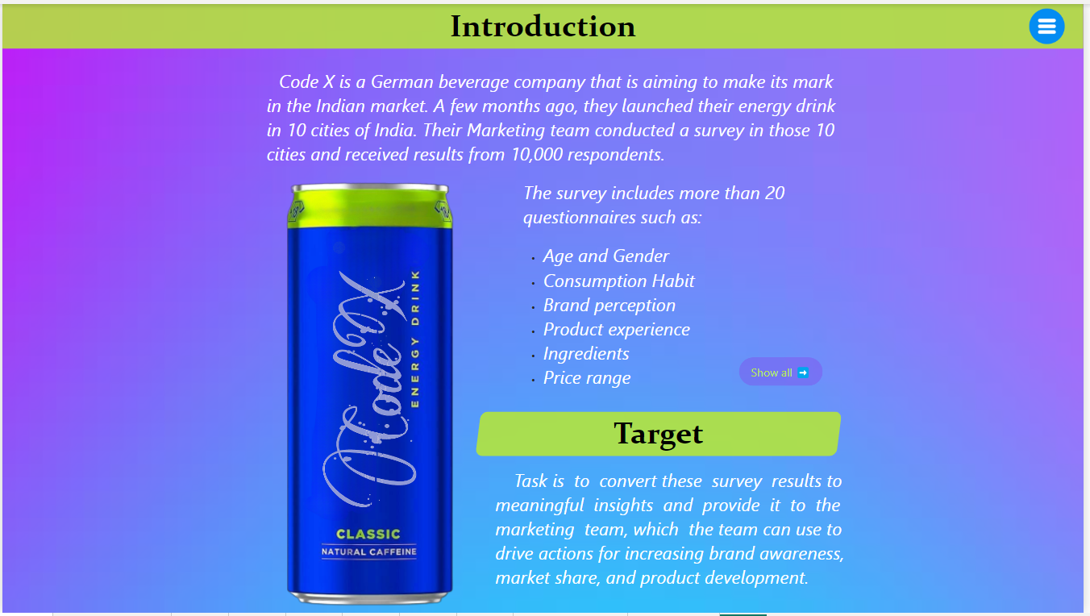

Slide 10
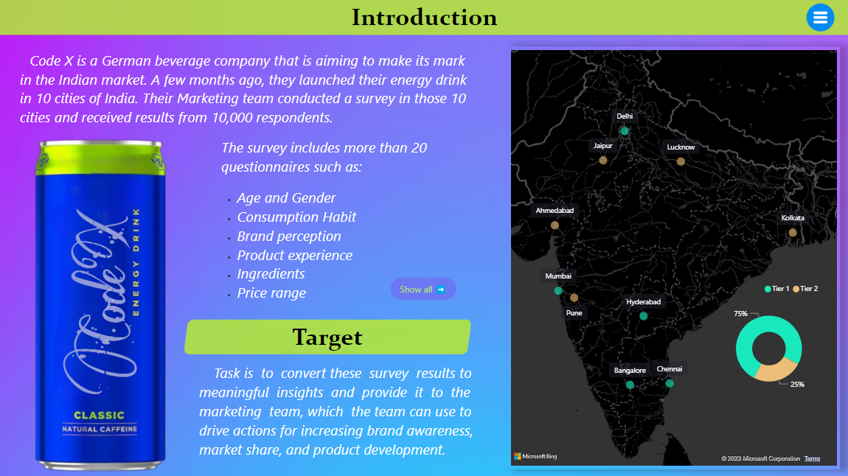
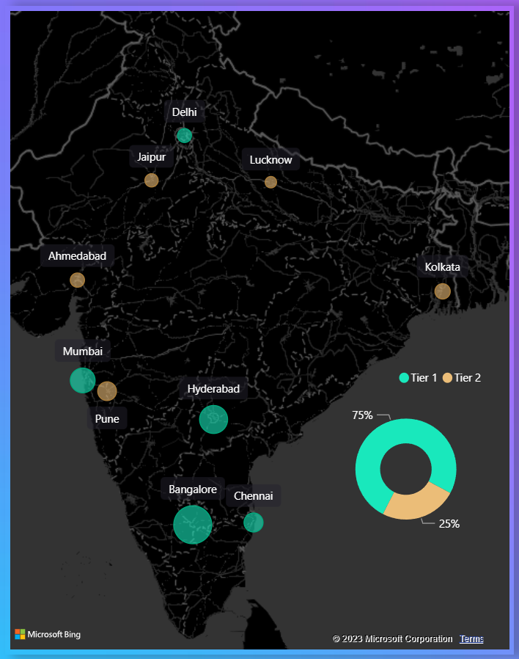

Slide 11
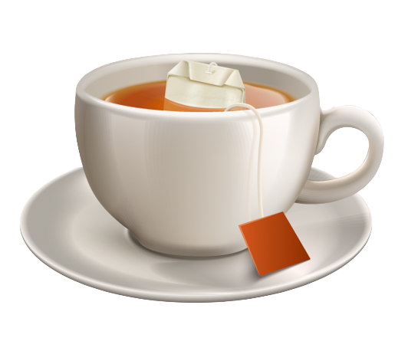
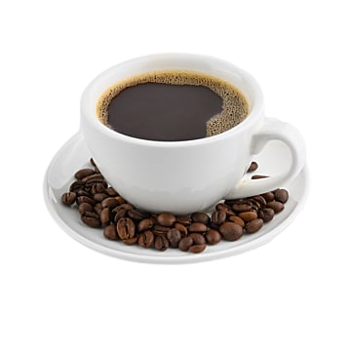
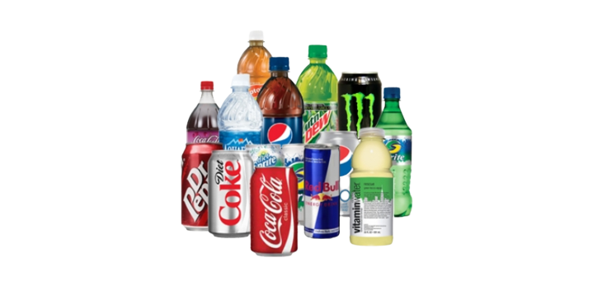
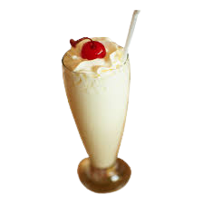
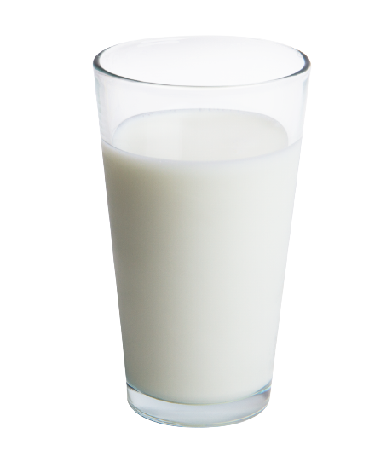
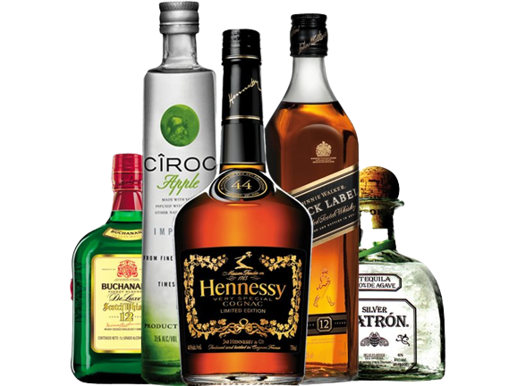
Domain Knowledge
Beverage: basically a drink other than water
Types
Hot Drinks
Dairy based Drinks
Alcoholic
Drinks
Soft Drinks

Slide 12




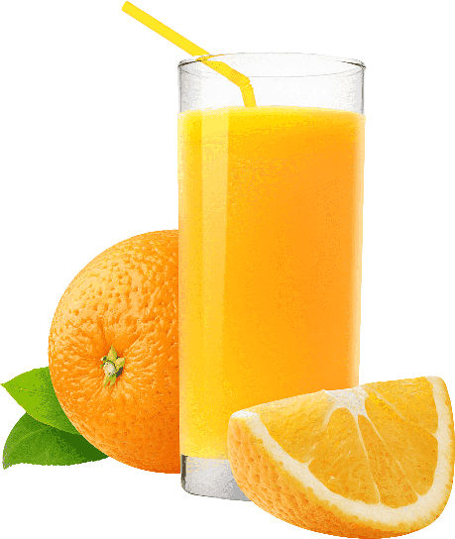

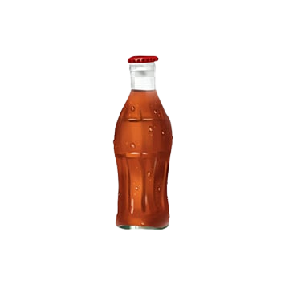
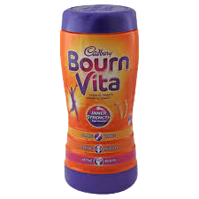
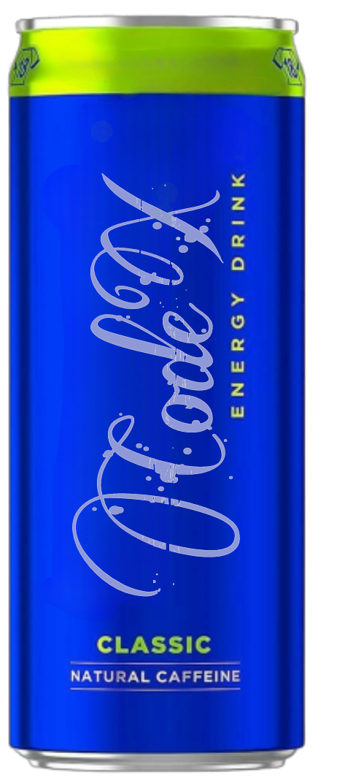
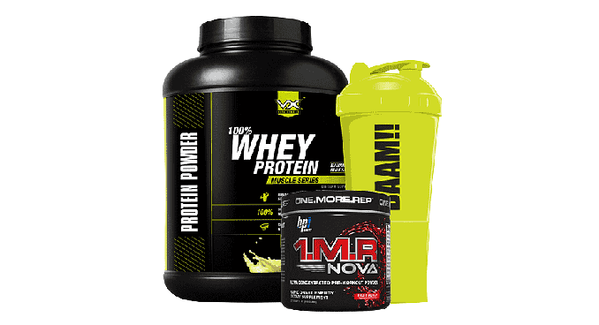
Domain Knowledge
Beverage Classification
Daily or Casual
purpose
Parties or Functions
purpose
Sports or wellness
purpose
Natural
Packaged

Slide 13

Energy Drink
An energy drink is nothing but a type of soft drink beverage that typically contains large amounts of caffeine and legal stimulants and is intended to boost energy, alertness, and concentration.
Energy Drink Market of India
As of 2022, the Indian energy drink market size is estimated to be around ₹3,500 crore. In Indian energy drink market has seen steady growth in recent years, with an annual growth rate of 8.5%. It is estimated that the category should touching Rs 10000 crores by 2027.

Slide 14


Key Metrics
1. Strong presence in South and West part of country
85%

Slide 15
Key Metrics
1. Strong presence in South and West part of country (i.e. about 85 %)
2. Consumption Frequency
Frequency
Yearly
Respondents
Units per year
Daily
365
1346 13.5%
4,91,290
44.6%
2-3 times a week
130
3491 34.9%
4,53,830
41.2%
Once a week
52
1609 16.1%
83,668
7.6%
2-3 times a month
30
1613 16.1%
48,390
4.4%
Rarely
12
1941 19.4%
23,292
2.1%
Inventory Cost
The expenses associated with purchasing, storing, and managing inventory throughout the supply chain.

Slide 16
Key Metrics
1. Strong presence in South and West part of country
2. Consumption Frequency
3. Taste Experience

Slide 17
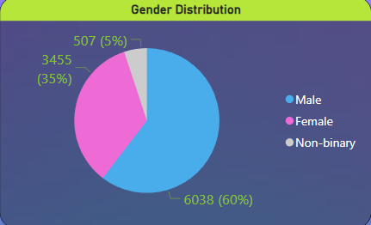
1. Demographic
a. Who prefers energy drink more? (male/female/non-binary?)
Male representing 60% of total respondents
Energy drinks are often used to increase physical stamina or activities associated with masculinity.
And brands also feature male athletes, which further attracts more male customers.

Slide 18
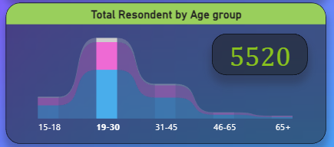
1. Demographic
b. Which age group prefers energy drinks more?
Age group between 19 - 30
As this age group consists mostly college students and young professionals, who need long study or work hours. Energy drinks are a way to stay awake, maintain focus, and increase productivity during these periods.

Slide 19
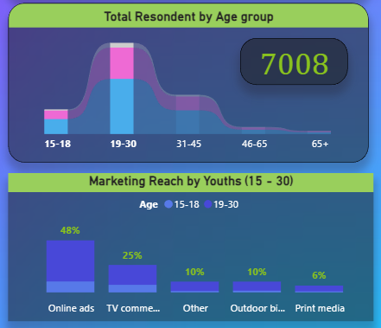
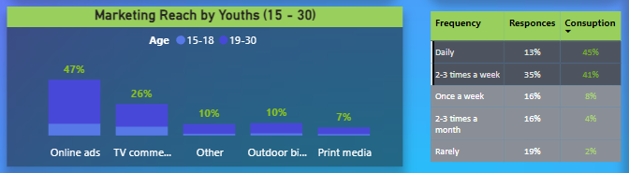
1. Demographic
c. Which type of marketing reaches the most Youth (15-30)?
Online ads
Youth spend a significant amount of time on social media, making it easier for energy drink brands to target them through online ads

Slide 20
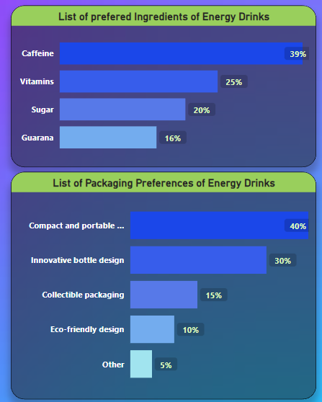
2. Consumer Preferences
a. What are the preferred ingredients of energy drinks among respondents?
Caffeine and Vitamins is mostly preferred.
Caffeine is a central nervous system stimulant that can increase alertness and reduce fatigue. More over it is rapidly absorbed into the bloodstream and works within 30 minutes after consumption. And it is what a energy drink is suppose to do.

Slide 21
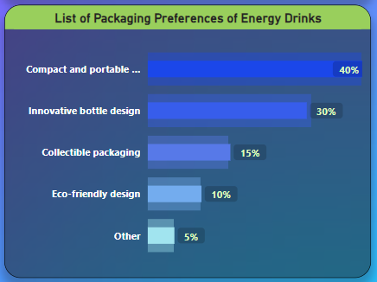
2. Consumer Preferences
b. What packaging preferences do respondents have for energy drinks?
Compact and portable cans is mostly preferred.
Compact and portable cans can be easily fit anywhere and more useful while traveling.
But innovative bottle designs and collectible packaging can’t be ignored as people often like these bottle for decoration.

Slide 22
3. Competition Analysis:
a. Who are the current market leaders?
ColaCoka, Bepsi and Gangstar are top 3 market leaders with a combine 65% of total market.
Brands with low price are dominating the market

Slide 23
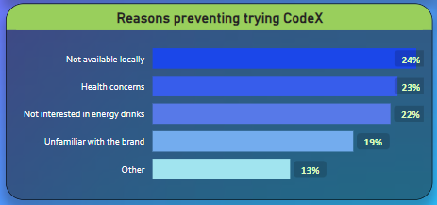
3. Competition Analysis:
b. What are the primary reasons consumers prefer those brands over ours?
Brand reputation, Taste/flavour and Availability.
Although brand reputation is the primary reason for choosing a brand over other, but for CodeX availability is a measure concern as it prevents our customers to try our brands.
More over customers don’t care about the effectiveness if the product is priced low.

Slide 24
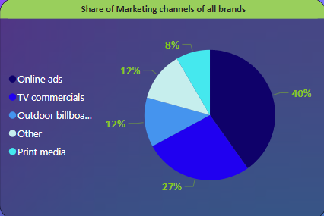
4. Marketing Channels and Brand Awareness:
a. Which marketing channel can be used to reach more customers?
Online ads
As majority of the customers are youth and todays youth spends most of the time online.

Slide 25
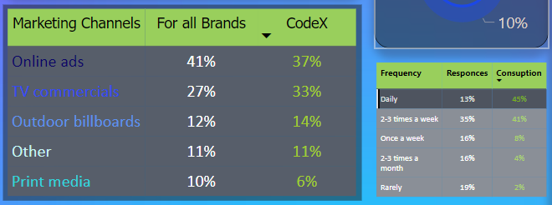
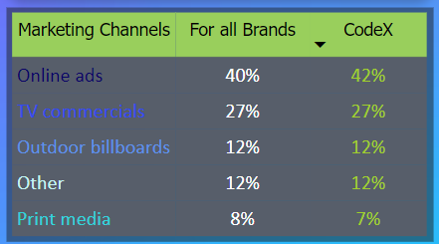
4. Marketing Channels and Brand Awareness:
b. How effective are different marketing strategies and channels in reaching our customers?
Online ads and TV commercials
We should not neglect TV commercials as it plays vital role for reaching a our prime customer i.e. the daily consumers.

Slide 26
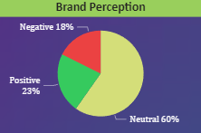
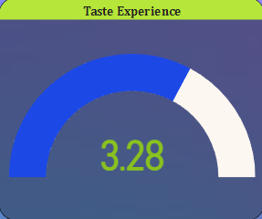
5. Brand Penetration:
a. What do people think about our brand? (overall rating)
Overall rating and brand perception is above average.
Energy drinks are not consider something for the sake of taste and also taste was not the primary reason for customers to prefer our brand.

Slide 27
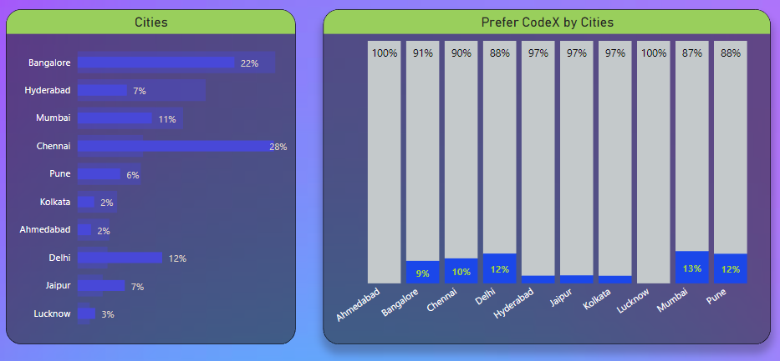
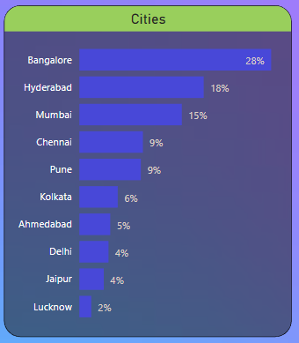
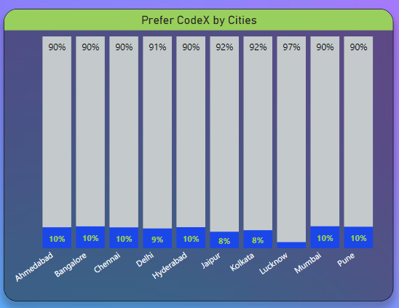
5. Brand Penetration:
b. Which cities do we need to focus more on?
Lucknow, Ahmedabad, Kolkata and Delhi.
Less number of respondents doesn’t necessarily means that market size is low it may be due to the populations of the city. City wise preference of codex will be a better Parameter.

Slide 28
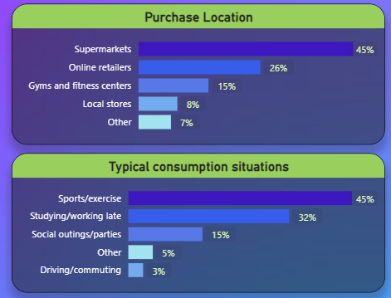
6. Purchase Behavior:
a. Where do respondents prefer to purchase energy drinks?
Supermarkets and online retailers.
There are more number of supermarkets and online grocery service are more common in the top cities in India.
But this may not be the case in tier 3 and small towns where most people are dependent on unorganised sectors.

Slide 29
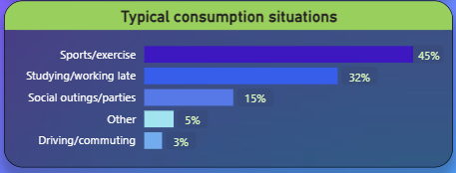
6. Purchase Behavior:
b. What are the typical consumption situations for energy drinks among respondents?
Sports/exercise and Studying/working late
Energy drinks are suppose to provide stamina and increase alertness which is obvious to be used for Sports and working late.

Slide 30
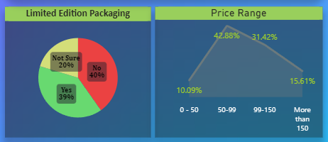
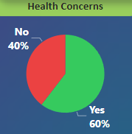
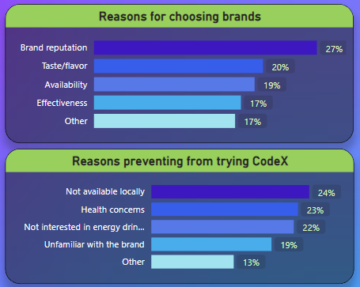
6. Purchase Behavior:
c. What factors influence respondents' purchase decisions, such as price range and limited edition packaging?
Price and health concerns
Limited edition packaging doesn’t have a very strong influence while price range and health concerns plays a very important role.
Health concerns was the 2nd most reason which prevents customers to try CodeX.

Slide 31
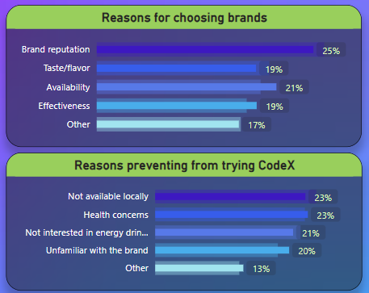
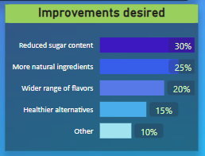
7. Product Development
a. Which area of business should we focus more on our product development? (Branding/taste/availability)
Availability
In spite of branding being the first reason to buy an energy drink we should focus more on availability, because availability is the key factor which is preventing customers to try CodeX and if a product is available in their locality it would by default increase the brand value.
And so far as Taste is concern it is not the 1st thing we should be focusing as most people suggest to reduce the sugar intake and add more natural products.

Slide 32
Secondary Insights
Recommendations for CodeX:
What immediate improvements can we bring to the product?
What should be the ideal price of our product?
What kind of marketing campaigns, offers, and discounts we can run?
Who can be a brand ambassador, and why?
Who should be our target audience, and why?

Slide 33
Secondary Insights
Recommendations for CodeX:
What immediate improvements can we bring to the product?
What should be the ideal price of our product?
What kind of marketing campaigns, offers, and discounts we can run?
Who can be a brand ambassador, and why?
Who should be our target audience, and why?

Slide 34
Forecasting
What should be the ideal price of our product?
Cost involved in producing an energy drink
1. Raw material cost
2. Manufacturing cost
3. Packaging cost
4. Transportation cost.
Cost of producing 1 can of Energy drink can be as low as Rs 7
Total cost = Rs 7 + Rs 10 = Rs 17 ( round off to Rs 20)

Slide 35
Forecasting
What should be the ideal price of our product?
We do not know what is the exact price a customer is willing to pay.
50
60
70
80
90
100
30

Slide 36
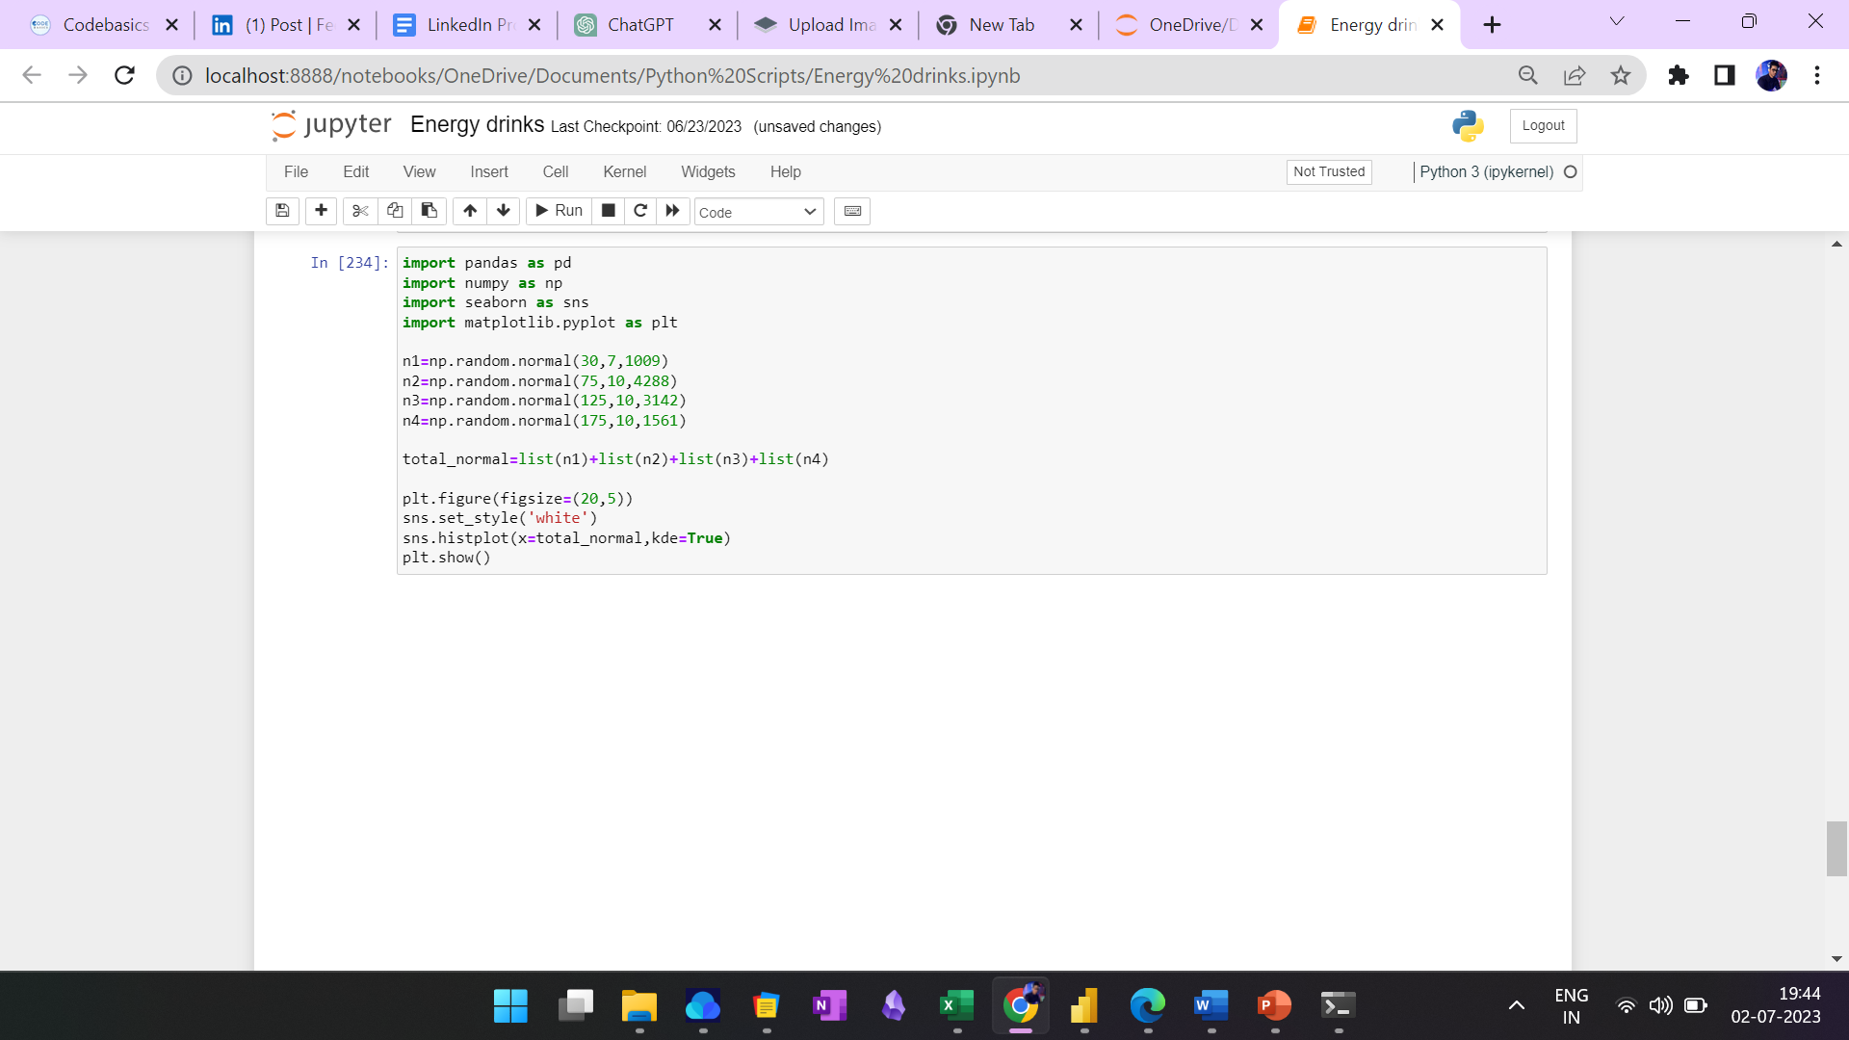
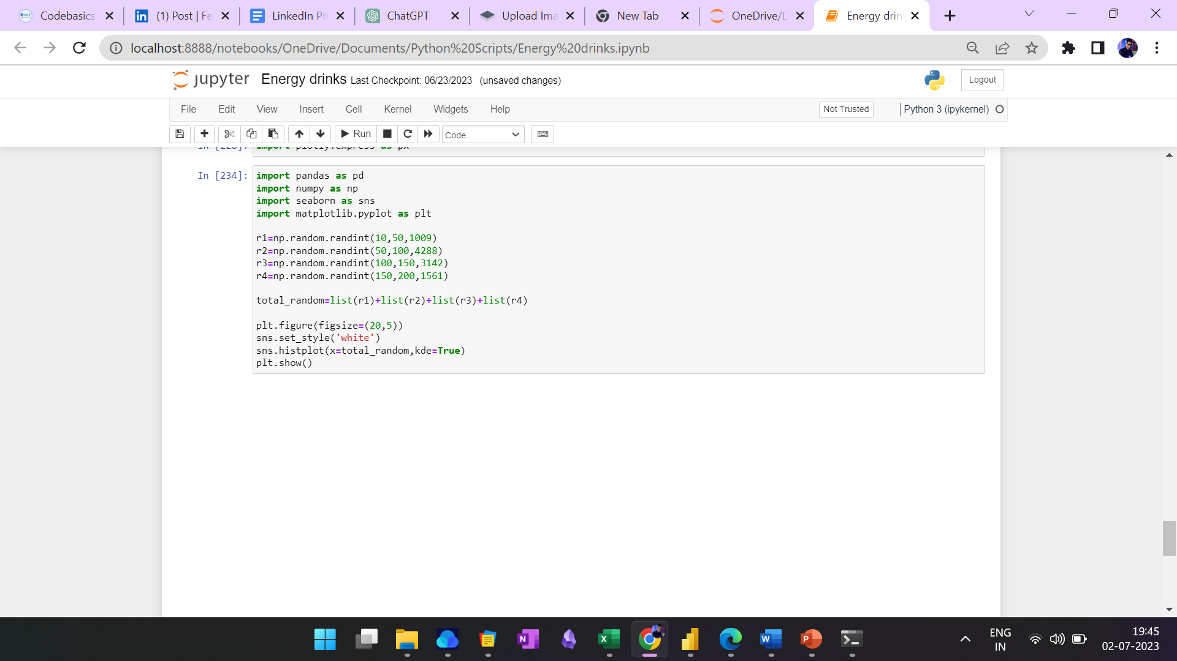
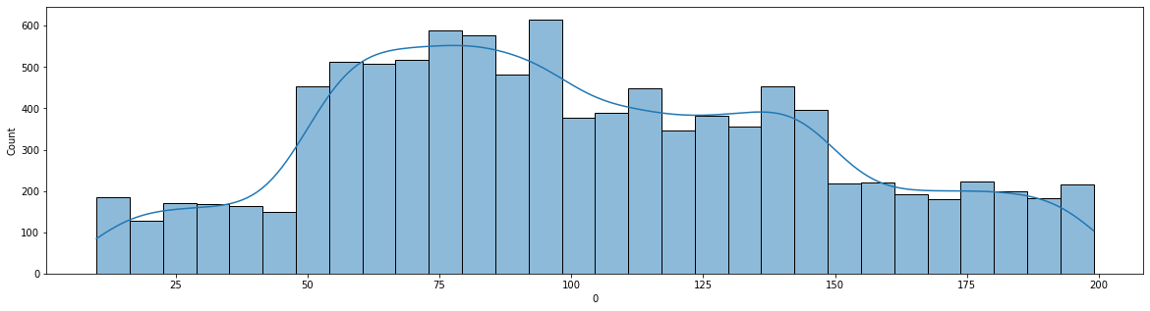
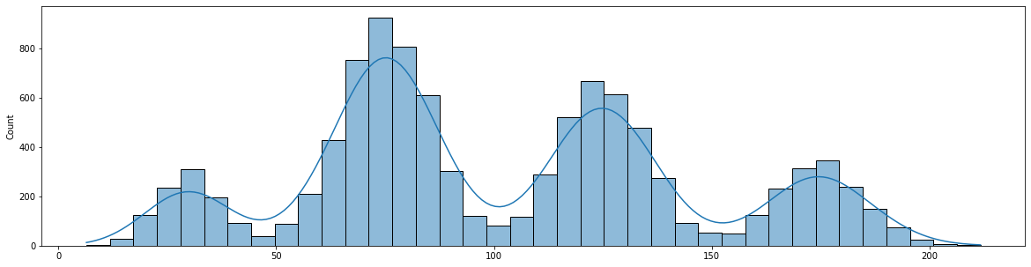
Forecasting
What should be the ideal price of our product?
Python simulation of 10000 data points representing different prices in the same range as of the survey data.

Slide 37
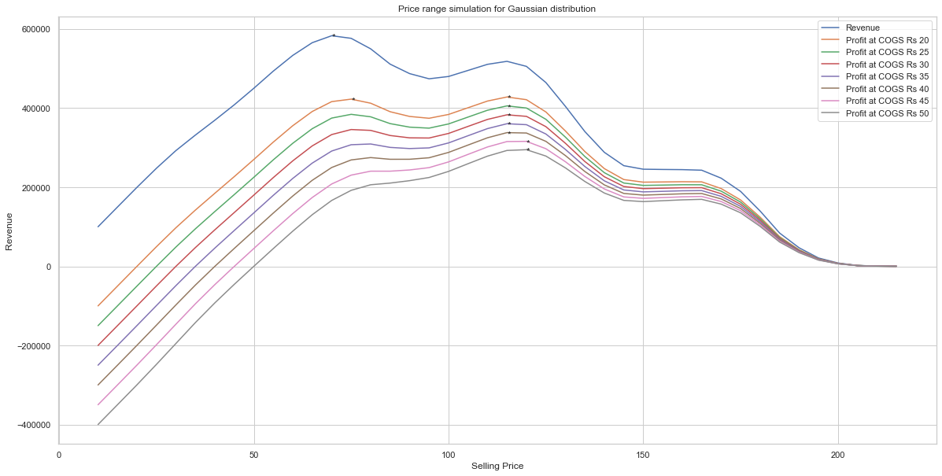
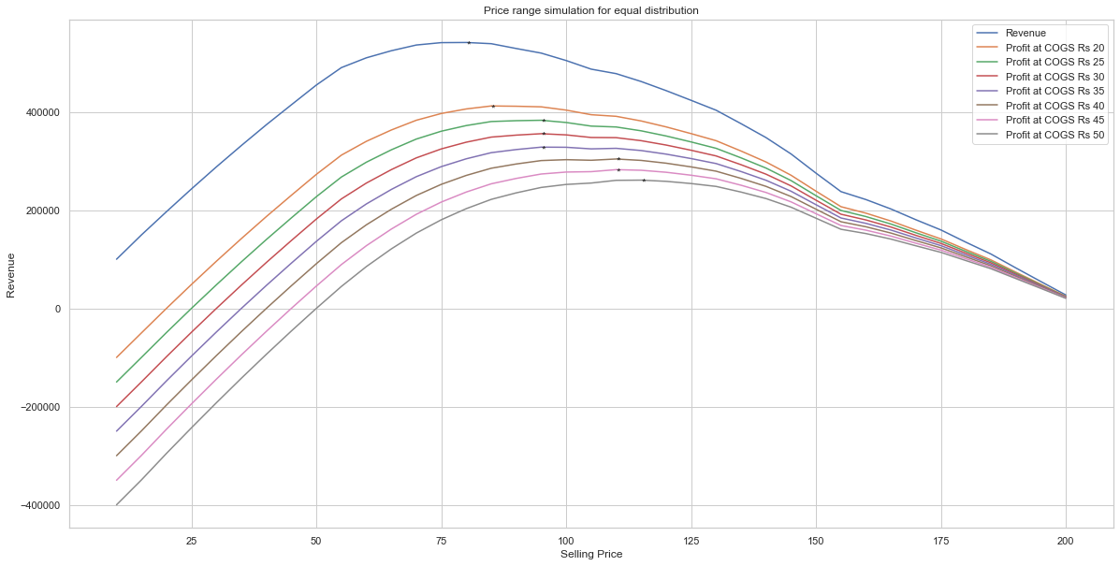
Forecasting
What should be the ideal price of our product?
At COGS | Gaussian Distribution | Random Distribution
Rs 20 | Rs 75 & Rs 115 | Rs 85
Rs 25 | Rs 115 | Rs 95
Rs 30 | Rs 115 | Rs 95
Rs 35 | Rs 115 | Rs 95 – Rs 100
Rs 40 | Rs 115 | Rs 110
Rs 45 | Rs 120 | Rs 110
Rs 50 | Rs 120 | Rs 115

Slide 38
Secondary Insights
What should be the ideal price of our product?
MRP Rs 115 discounted to Rs 99 at bulk order for 300 ml can
And also keeping in mind the market price of our competitors we are still Rs 10 cheaper than BlueBull and Gangster.
This price won’t affect our profit even if the inflation rises. Where all our competitors will be increasing there price we can still offer at the same cost.
As most of the customer buys from super market and online retailers where it is easier to sell at packs of 6 and 12.
Brands | Quantity | MRP
Bepsi | 250 ml | Rs 35
ColaCoka | 250 ml | Rs 40
Sky9 | 250 ml | Rs 50
Gangster | 350 ml | Rs 125
BlueBull | 250 ml | Rs 125

Slide 39
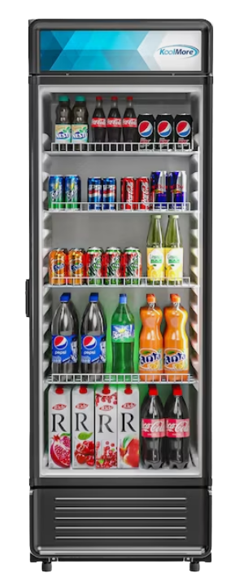
Secondary Insights
What immediate improvements can we bring to the product?
More slim packaging and add natural ingredients.
More number of Cans can hold in the self of the refrigerator reducing the storage cost and saves the overall transportation cost

Slide 40
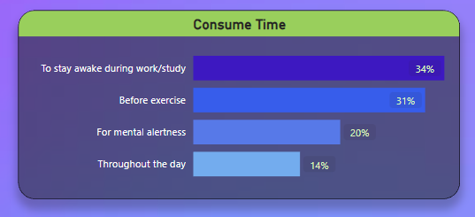
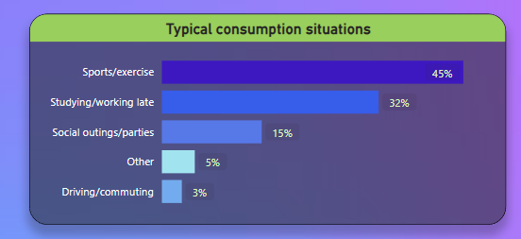
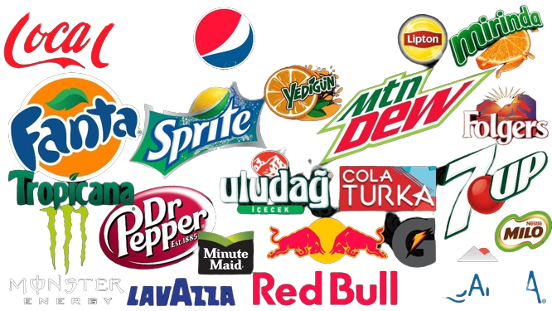
Secondary Insights
Who should be our target audience, and why?
Youth between the age 15 – 30 who are students and working professionals
While all brands are targeting the sports enthusiast it is a great opportunity for us to target the students and working professionals who consume energy drink to stay awake.
If we position our brand as sport energy drink we can capture mostly the male population but students and working professionals can be both male and female. Thus we will get the advantage to both the genders.
We must not ignore the population between 15- 18 as after few years when these people will grow up and start earning, can be our great potential client.
Study / work
Sports / exercise

Slide 41
Secondary Insights
Who can be a brand ambassador, and why?
Points to consider:
Relevance: The brand ambassador personality should resonate with the brand's identity.
Reach and influence: Should be reachable to our target audience and have a strong presence in the targeted marketing channels.
Exclusivity: The brand ambassador must not be associate with other brands in same industry.

Slide 42

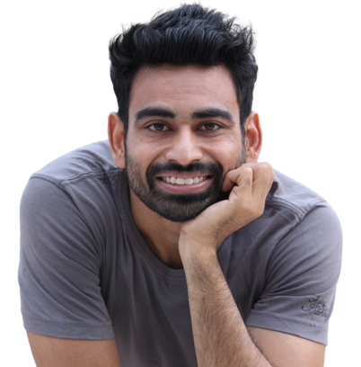

Secondary Insights
Who can be a brand ambassador, and why?
Self development and educational content creators.
As they have a strong social media presence and most importantly not associated with any other brands in our industry.
Endorsing a social media creator is less expensive than a professional athlete or actor.
And cherry on the cake youtubers like Ranveer Allahbadia and Fittuber are also associated with fitness.

Slide 43
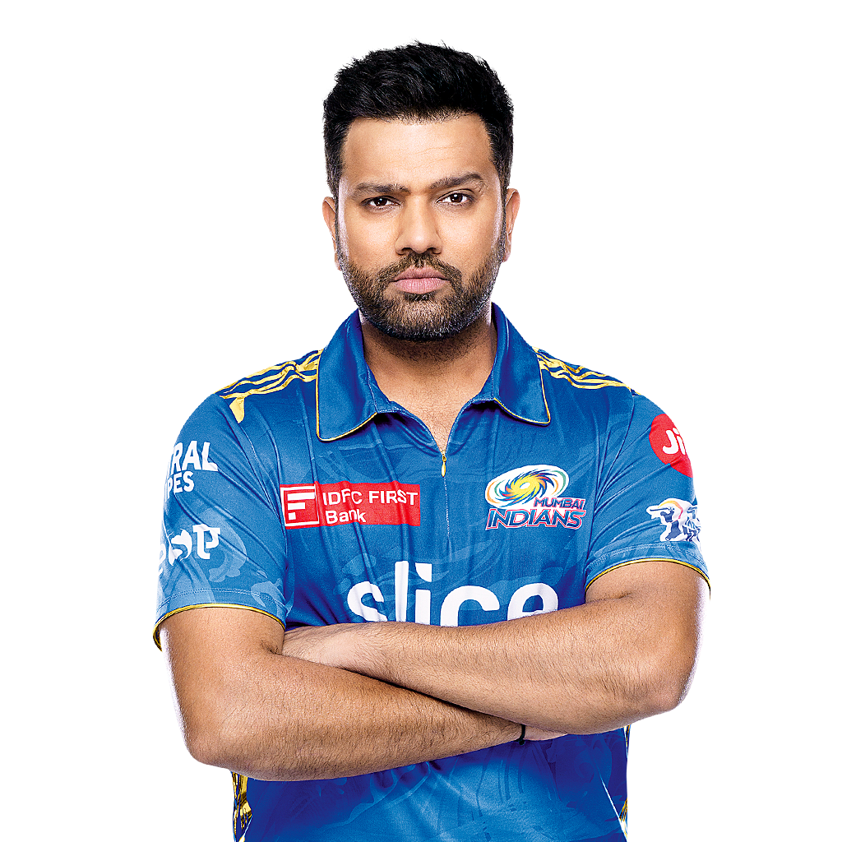
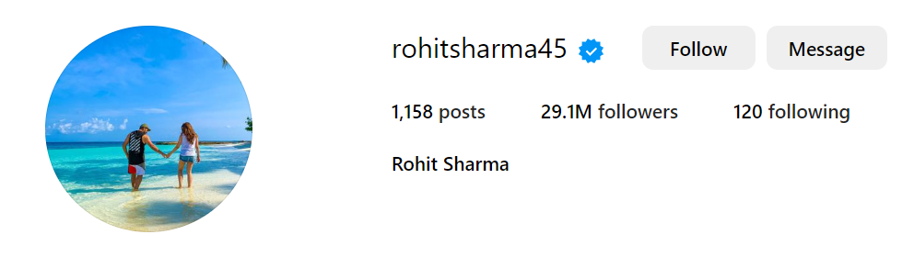

Secondary Insights
Who can be a brand ambassador, and why?
Rohit Sharma
Have a very strong fan following in social media and mostly followed by young males. And most importantly not associated with and other brands.

Slide 44


Secondary Insights
What kind of marketing campaigns, offers, and discounts we can run?
Marketing campaign: Online ads and podcast title sponsor.
Offers and discounts: User generated marketing where a user can get discounts on his next order if they share their experience with our brand on social media.

Slide 45
Conclusion
Thinking on behalf of the retailer should be our first priority. We should be aware of the inventory cost associated with the product.
Our market capitalization in North and East are very low, we should be focusing on those areas more.
We should add more natural and healthy ingredients as health concerns are one of major reason that is preventing our customers to try energy drinks and at any cost health should not be compromised.
While all brands are fighting hard to capture the young male and sports segment, it’s a big opportunity for us to capture both male and female by focusing on the customers who buy for study or work purposes.
We should not be spending a huge amount of money into celebrity endorsements or sponsoring large sports events rather our focus must be on improving the quality, customer experience and give retailer margin.

Slide 46







Special Thanks
Bhavin
Patel

